Slide 1
Streamlining Supplier Onboarding : Leveraging Vendor APIs for Efficient and Seamless Registration
Session 39

Slide 2
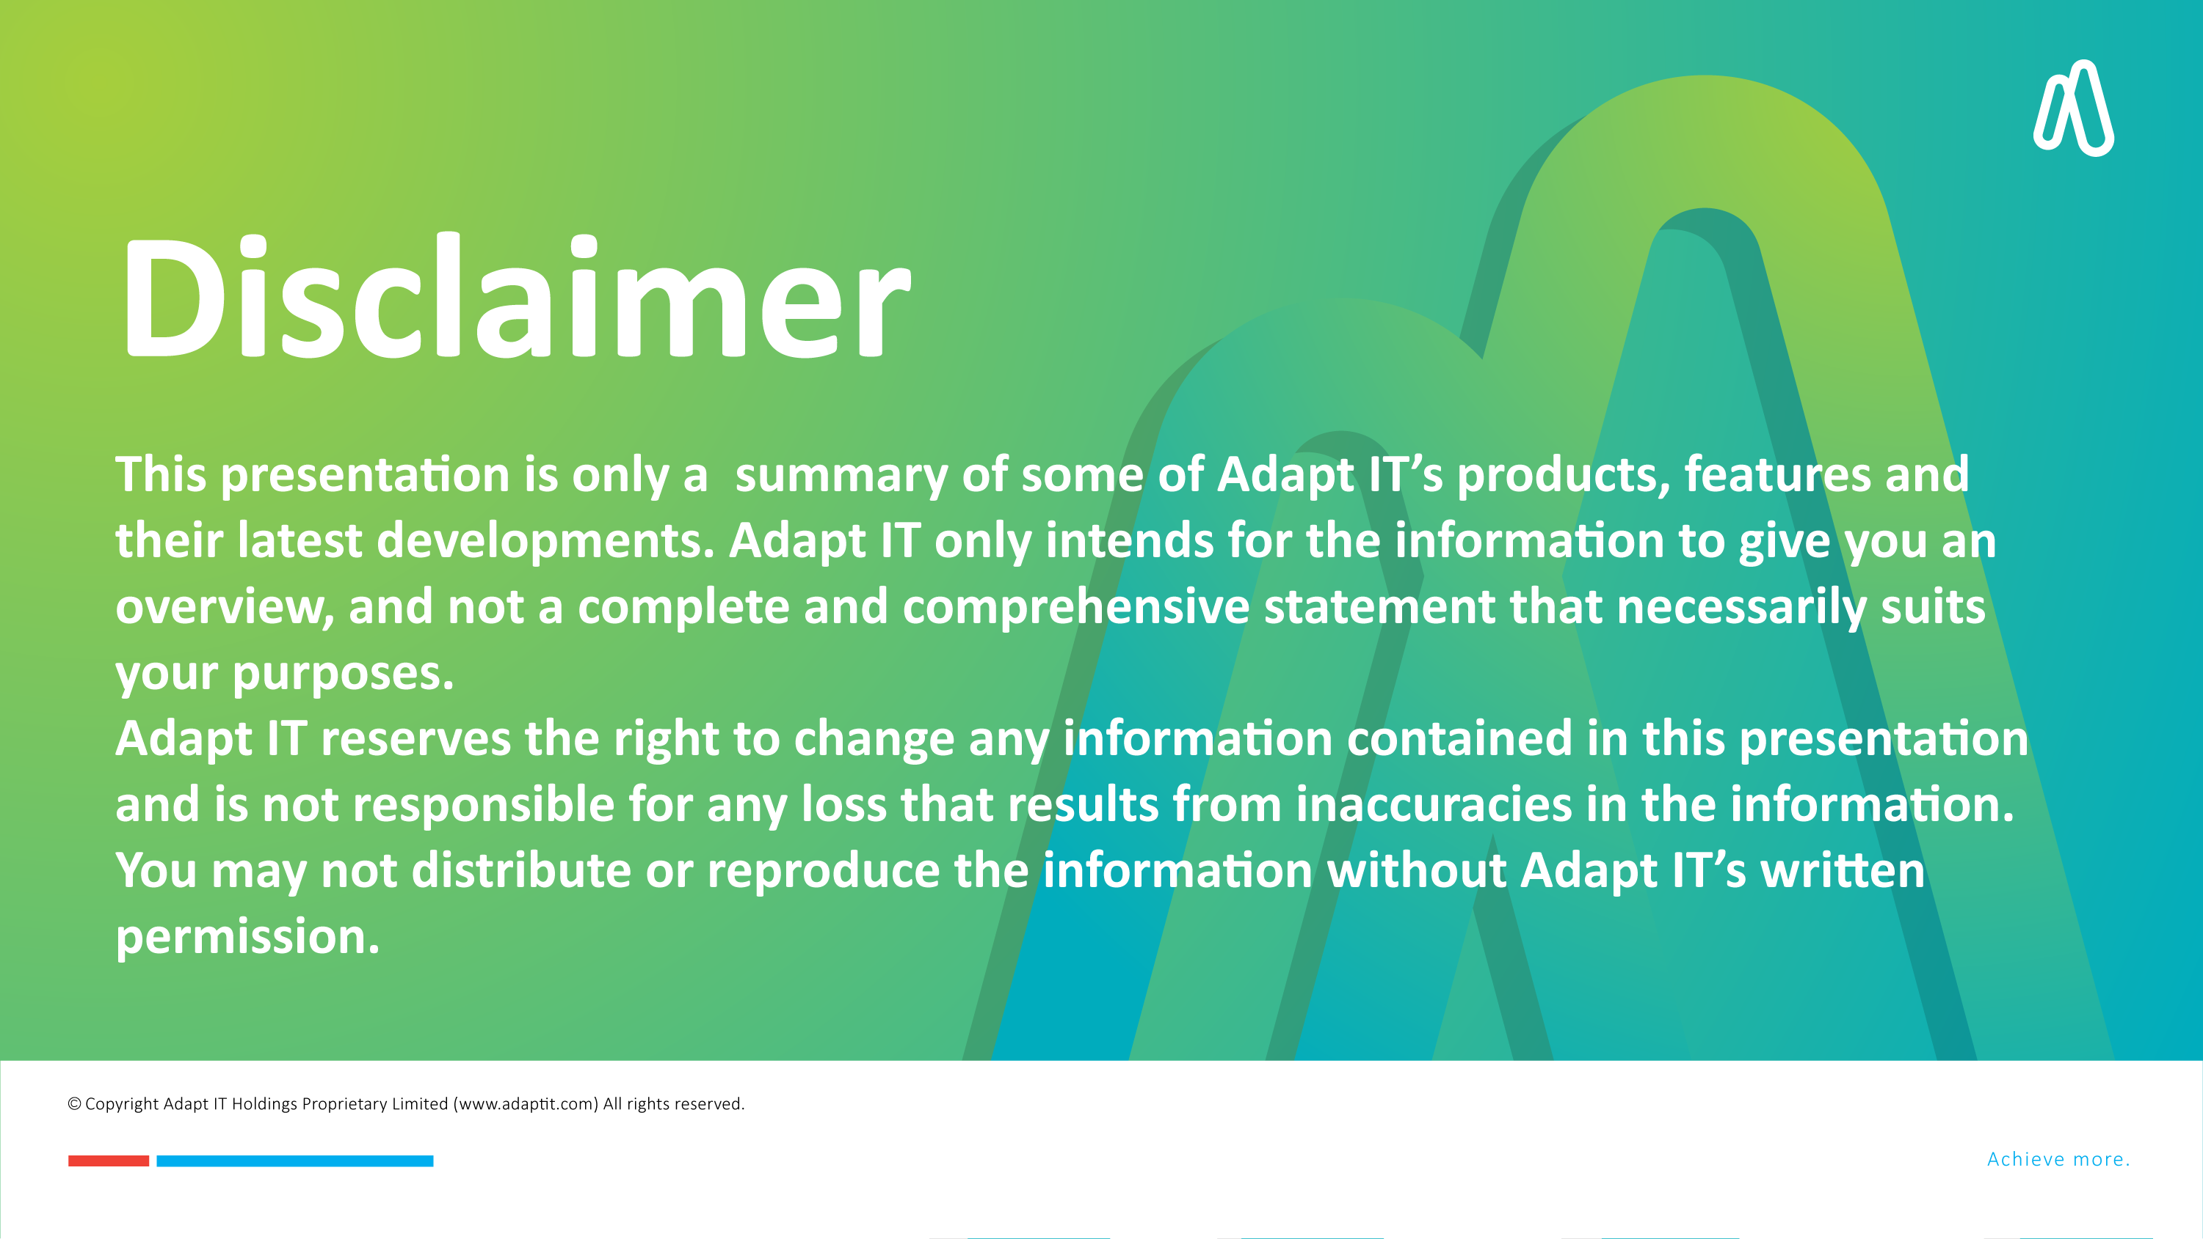

DISCLAIMER
This presentation is only a summary of some of Adapt IT’s products, features and their latest developments. Adapt IT only intends for the information to give you an overview, and not a complete and comprehensive statement that necessarily suits your purposes.
Adapt IT reserves the right to change any information contained in this presentation and is not responsible for any loss that results from inaccuracies in the information. You may not distribute or reproduce the information without Adapt IT’s written permission.

Slide 3

Background on MoonFlow
  - Mzimhle Mbijekana
ITS Integration with MoonFlow
  - Brilliant Tleane
MoonFlow Demo
  - Willie de Jonge
Way Forward
  - JJ Swanepoel
Q&A Session
Table of contents

Slide 4
Background on MoonFlow

Slide 5

Background on MoonFlow
Moon Bouncer has entered into a partnership with Adapt IT to Interface with MoonFlow solution for SCM automation at Institutions.
The integration will cover four main modules, namely:
  Supplier Registration,
  Supplier Rotation in RFQ’s,
  Contract Management,
  Tender Administration
These processes will be developed and implemented in a phased approach
Procurement management and processing of requests/transactions to remain in the ITS system.

Slide 6
ITS Integration with MoonFlow

Slide 7

ITS Integration with MoonFlow
Supplier registration will be done on MoonFlow portal
Allows for attachment of all relevant documentations
CSD validation and other compliance check such as SARS will be done
Supplier Verification and Approvals is applied on MoonFlow prior to integration into ITS.
Data will be pushed seamlessly into ITS System via Vendor API
(Security check)

Slide 8
Value Proposition
Efficiency:
Accelerate supplier registration and maintenance processes with automation.
Automated Processes: Eliminate manual processing for suppler information when onboarding a supplier.
Compliance:
Ensuring procurement with compliant Supplier’s vetted thereby maintaining good audit governance and brand image creditability of the institution.
Security:
Data will be transferred securely through API’s to reduces the possibility of important information and personal data being stolen or compromised.
Integration:
The solution will provide seamless integration between 3rd Party and ITS PM system.

Slide 9
MoonFlow Demo

Slide 10
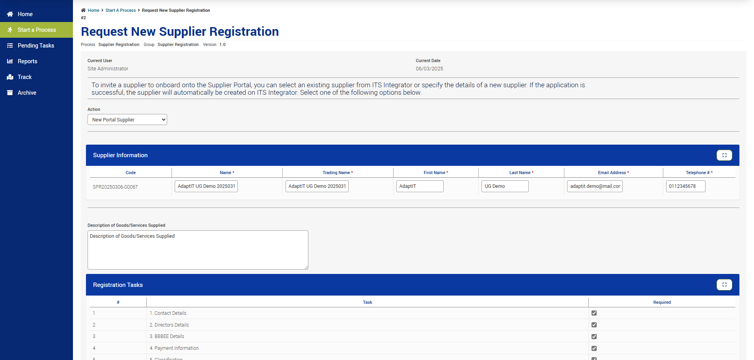
Demo

Slide 11
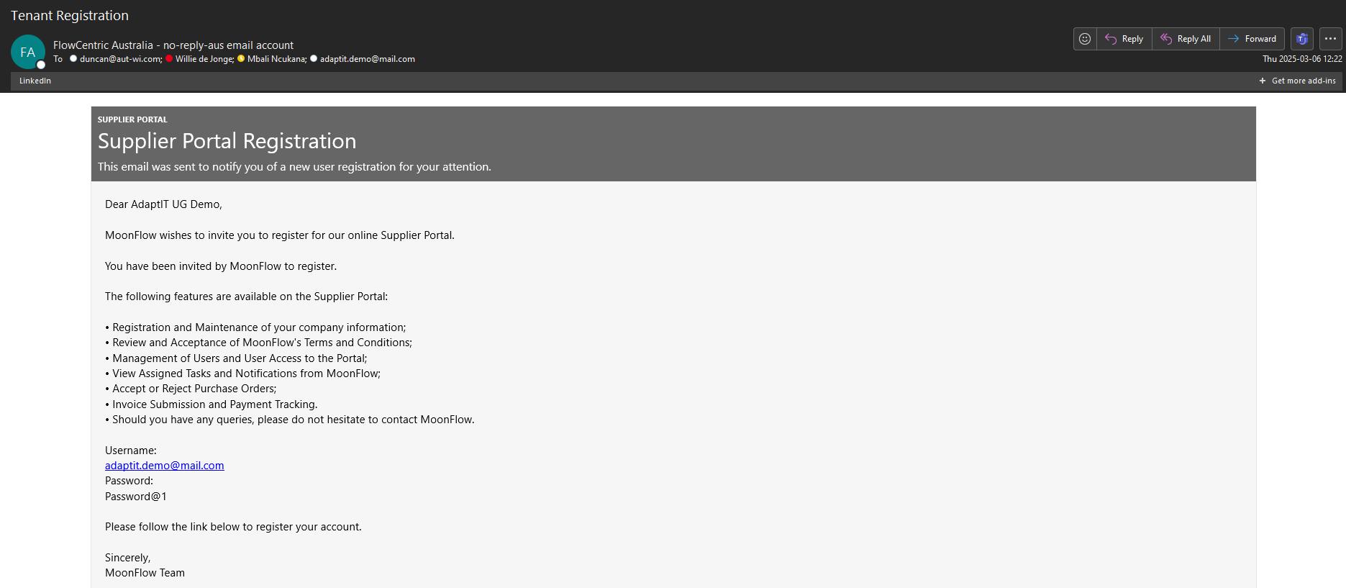
MoonFlow Communications
MC

Slide 12
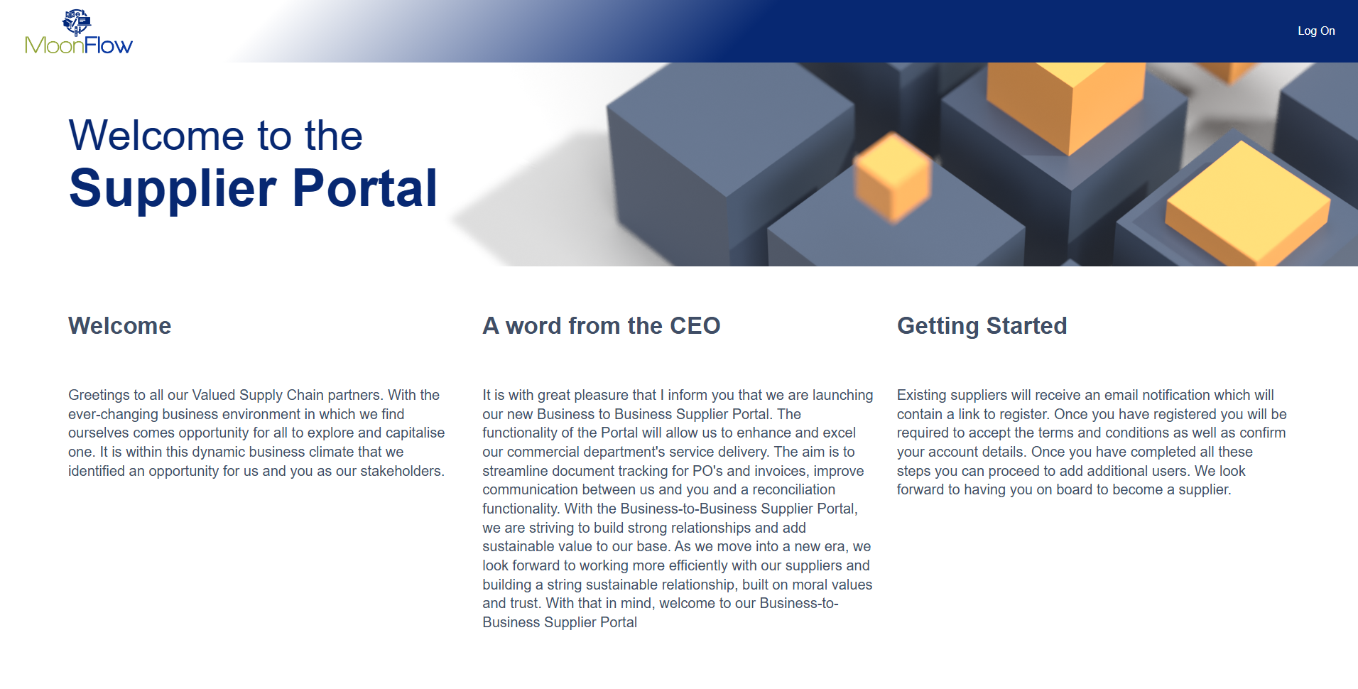

Slide 13
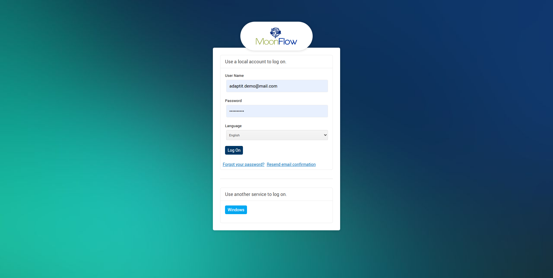

Slide 14
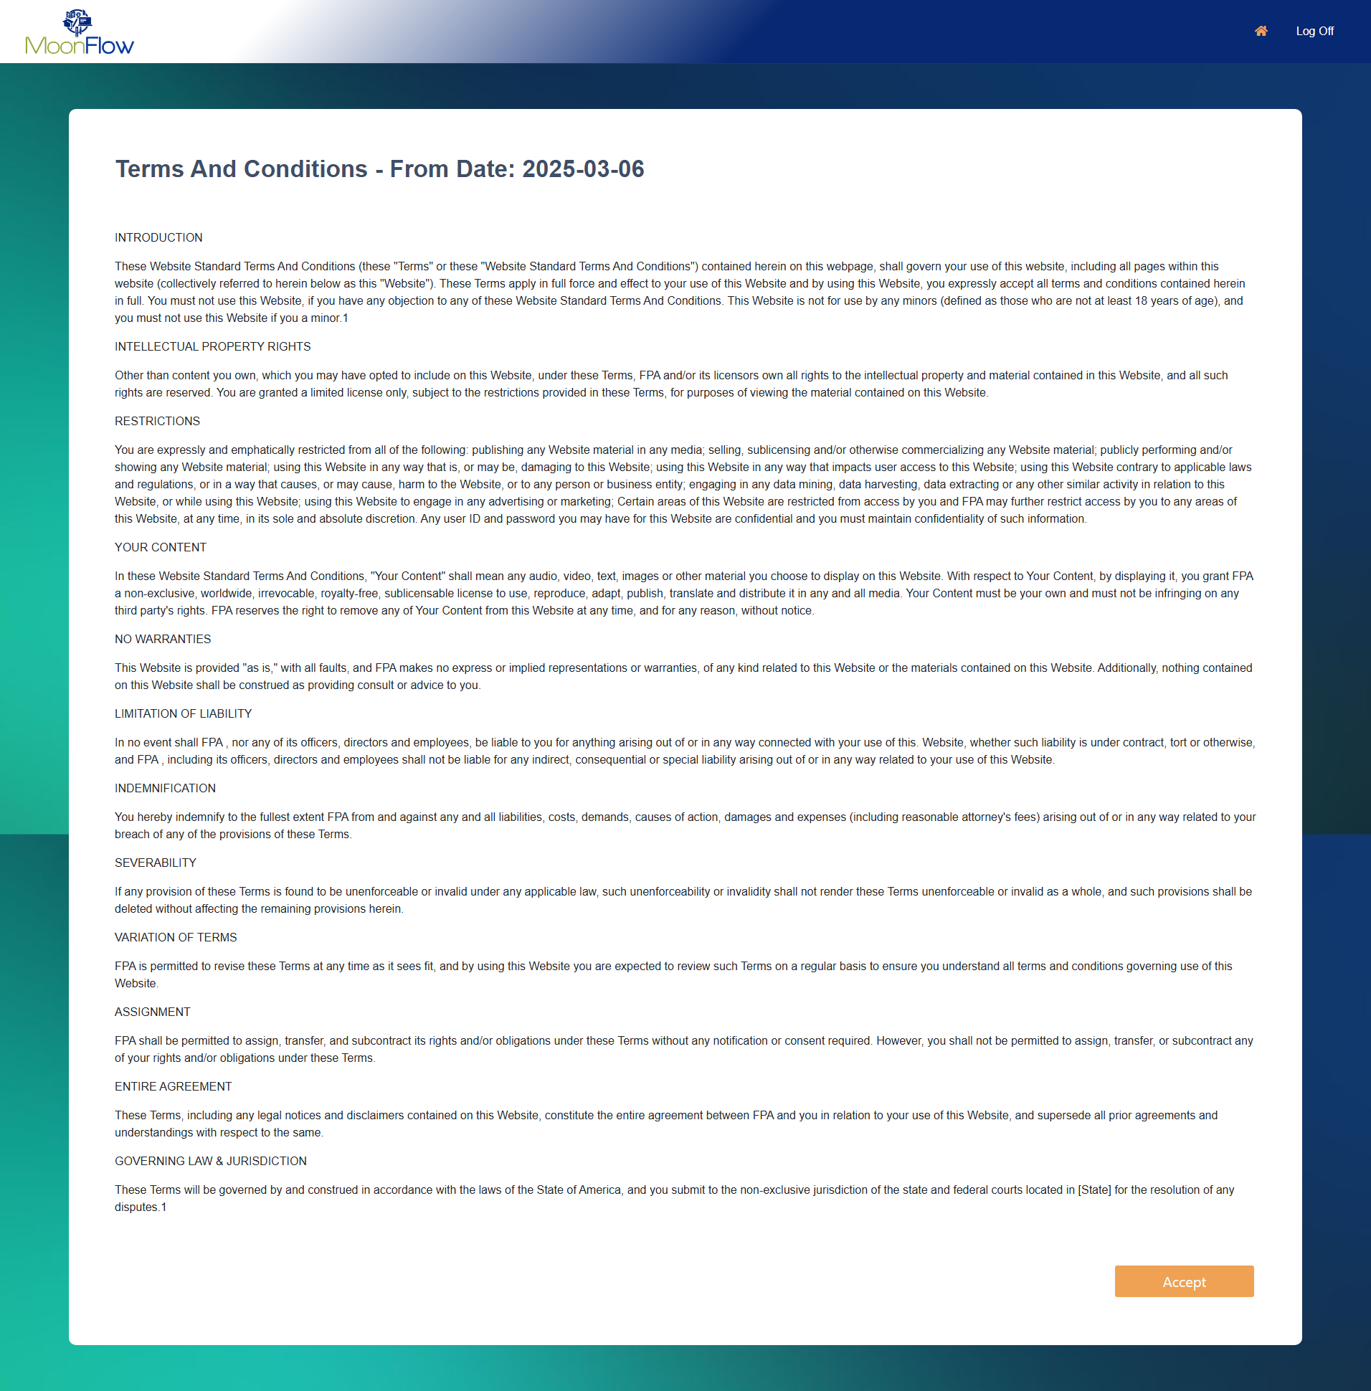

Slide 16
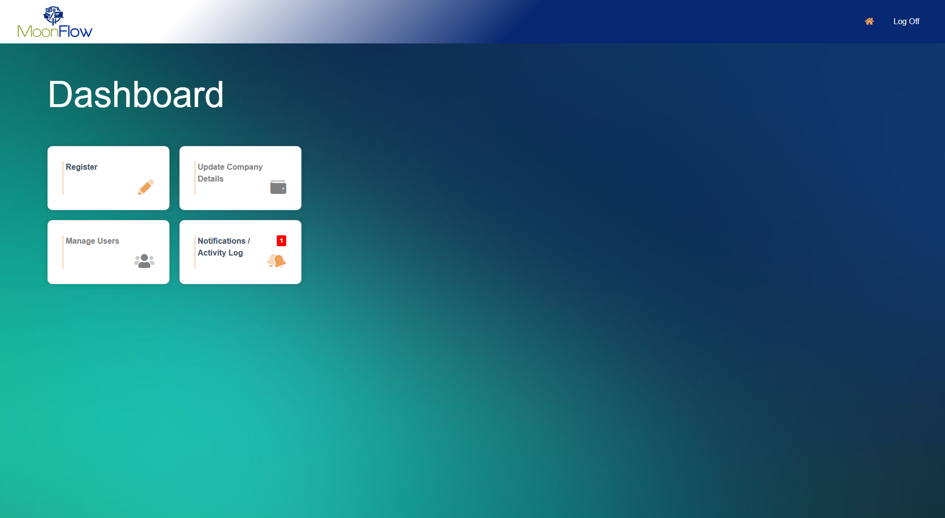

Slide 17
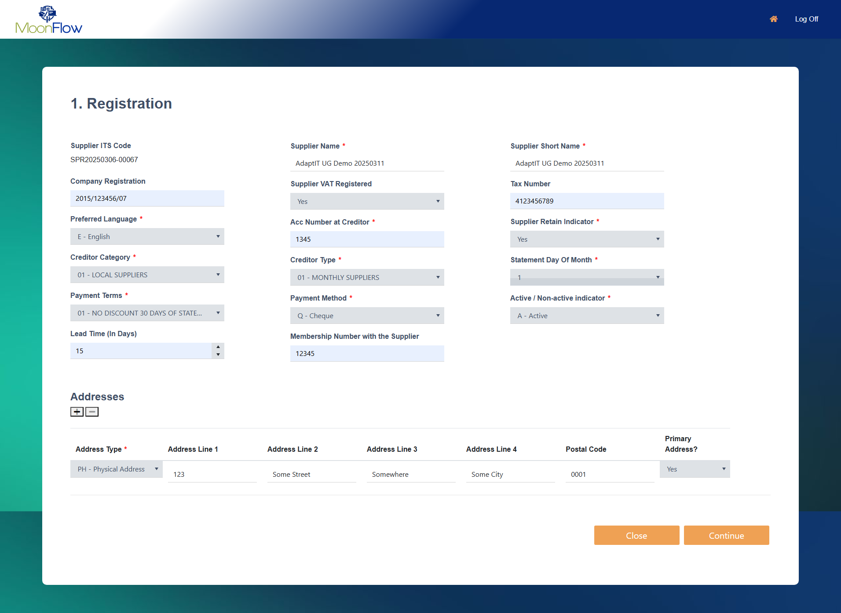

Slide 18
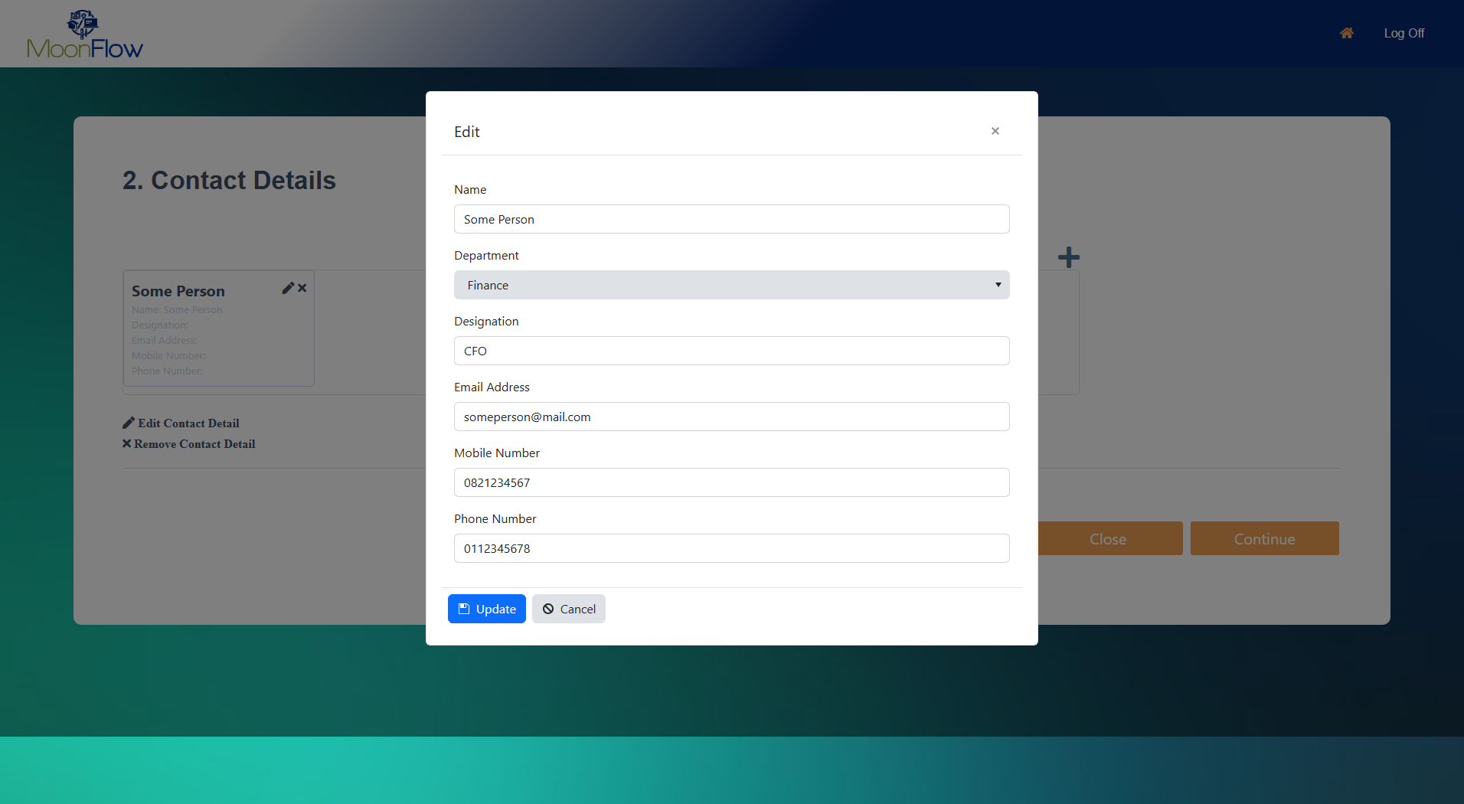

Slide 19
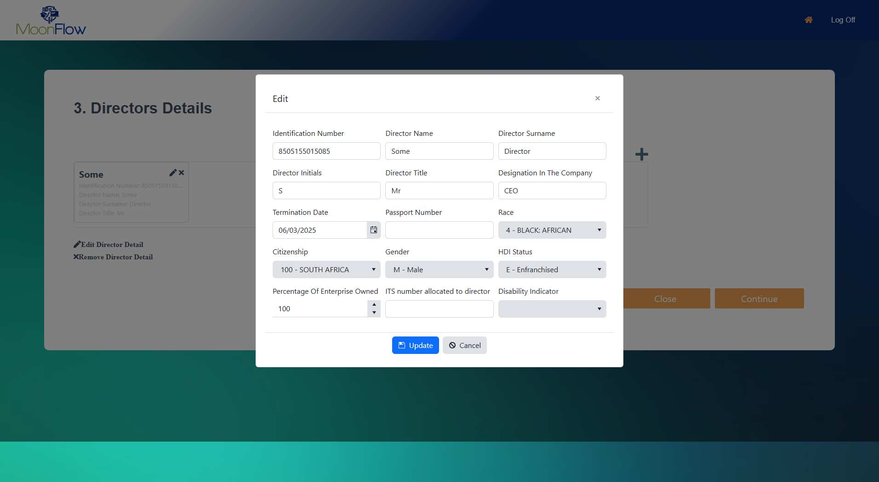

Slide 20
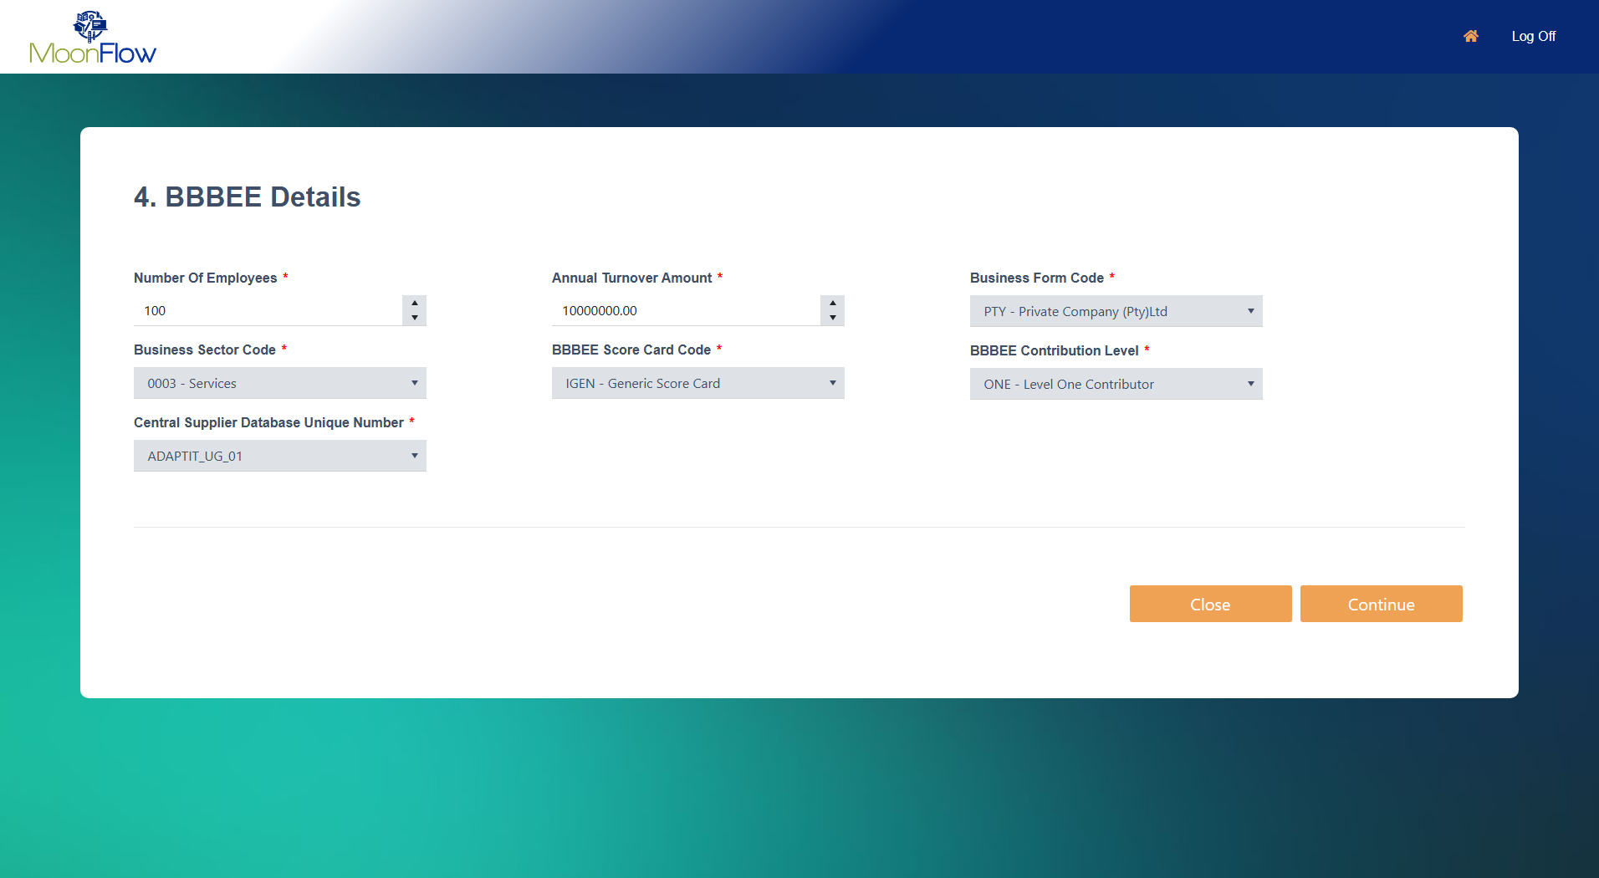

Slide 21
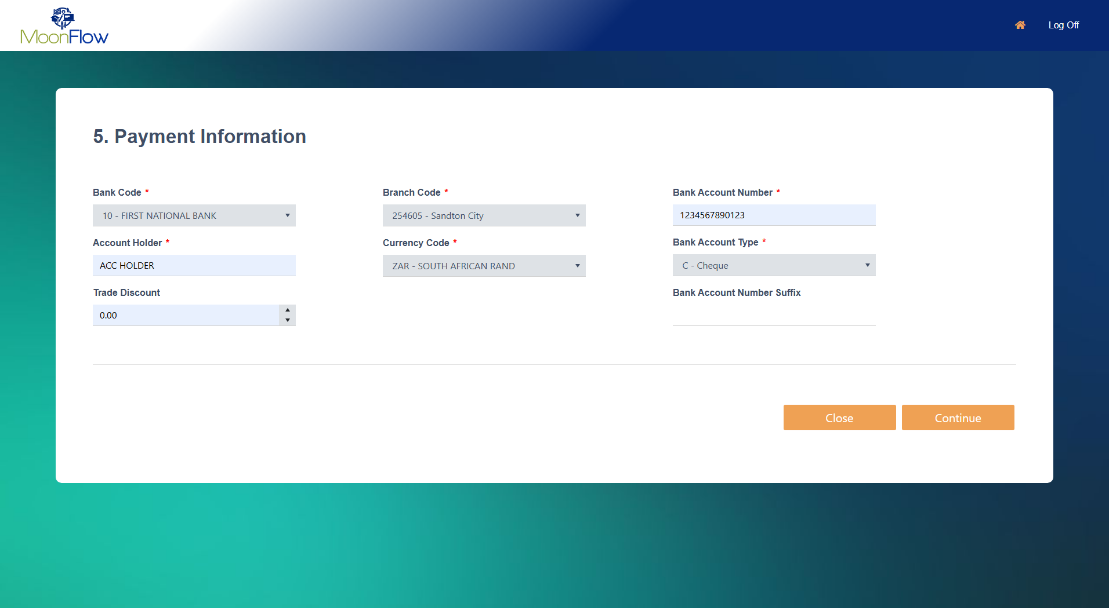

Slide 22
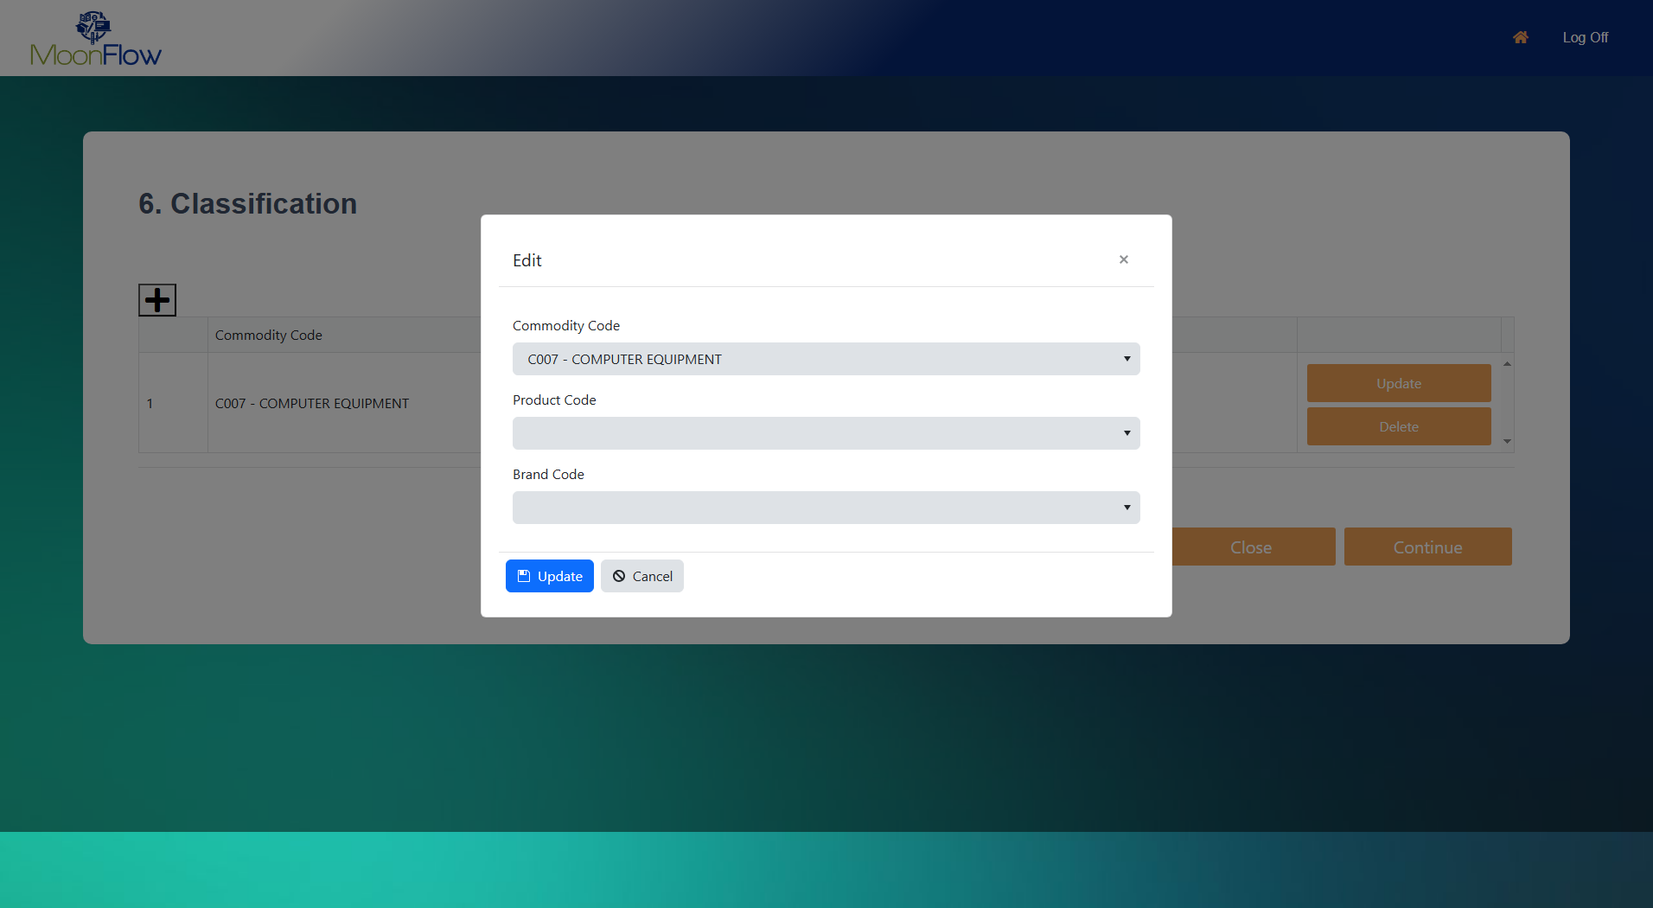

Slide 23
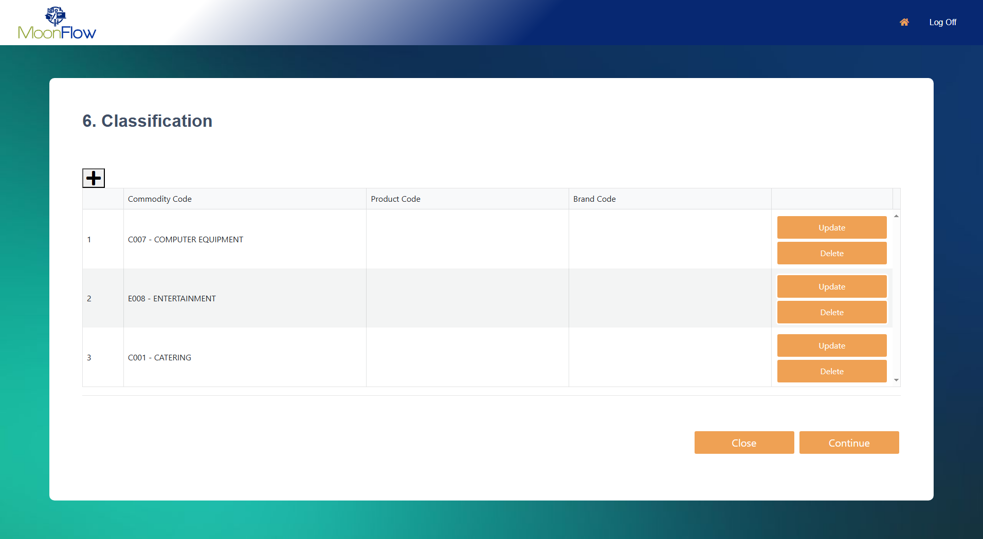

Slide 24
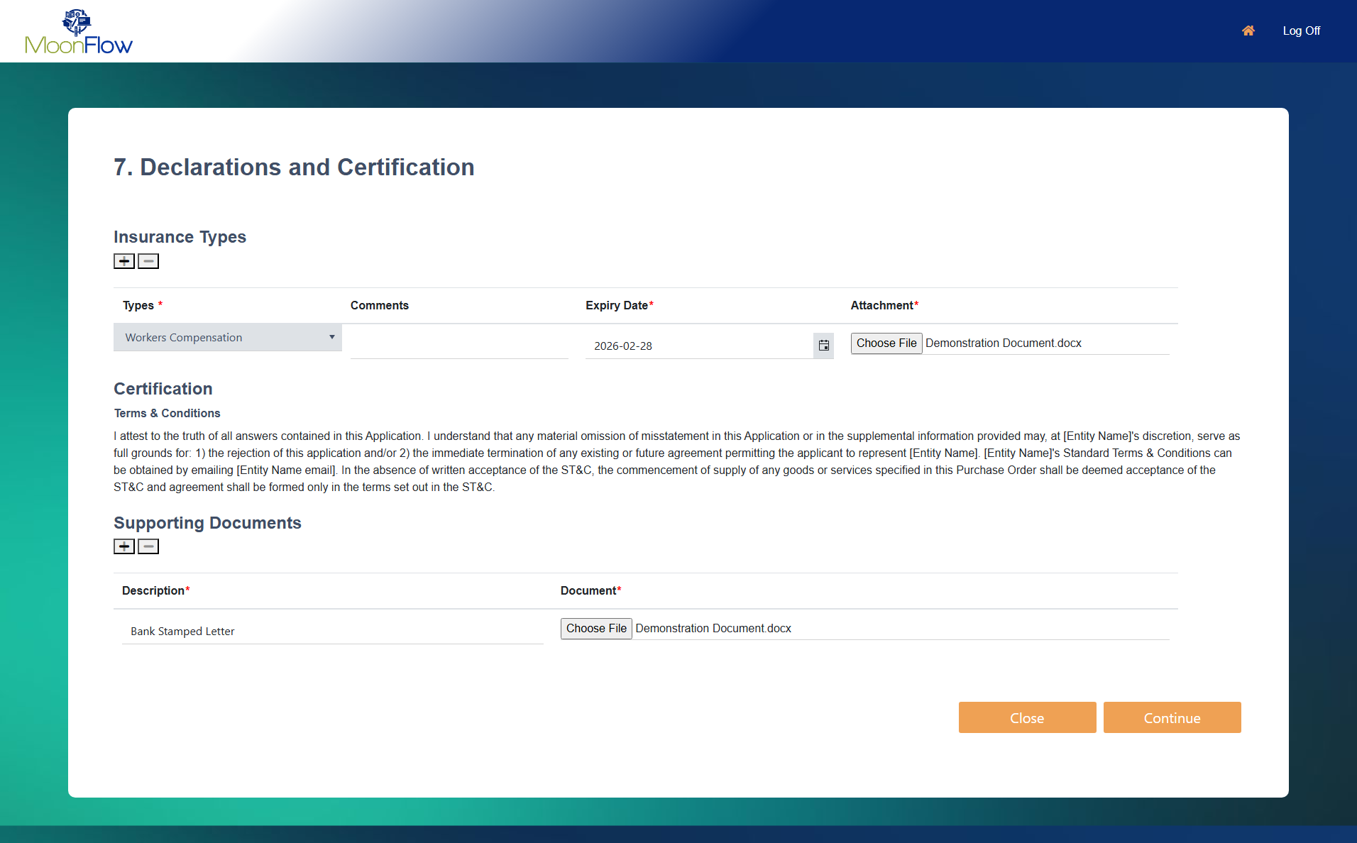

Slide 25
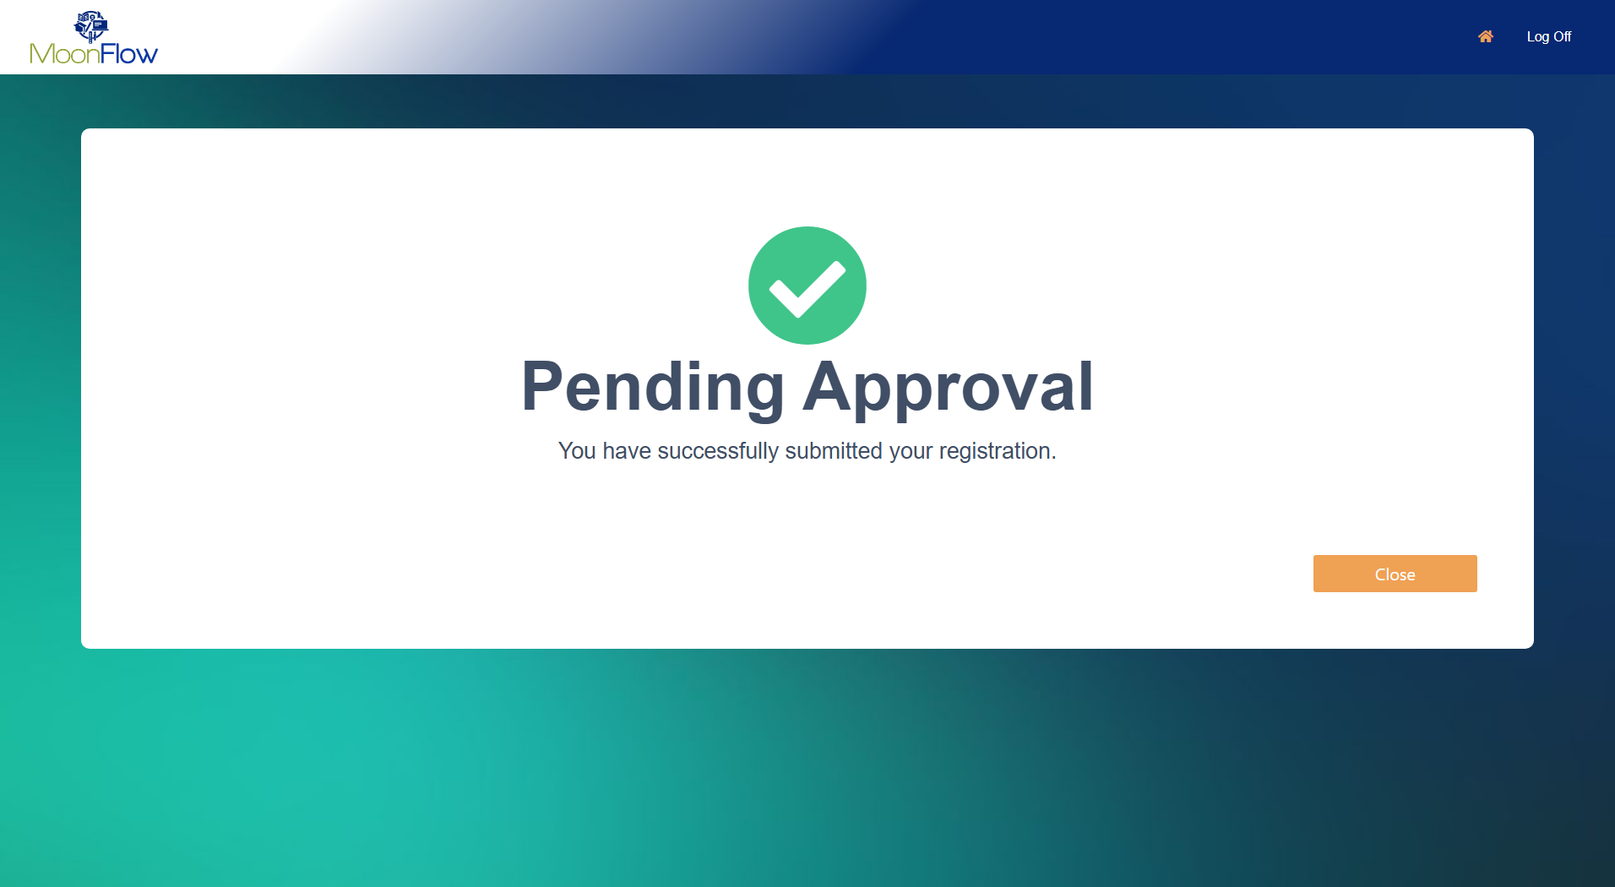

Slide 26
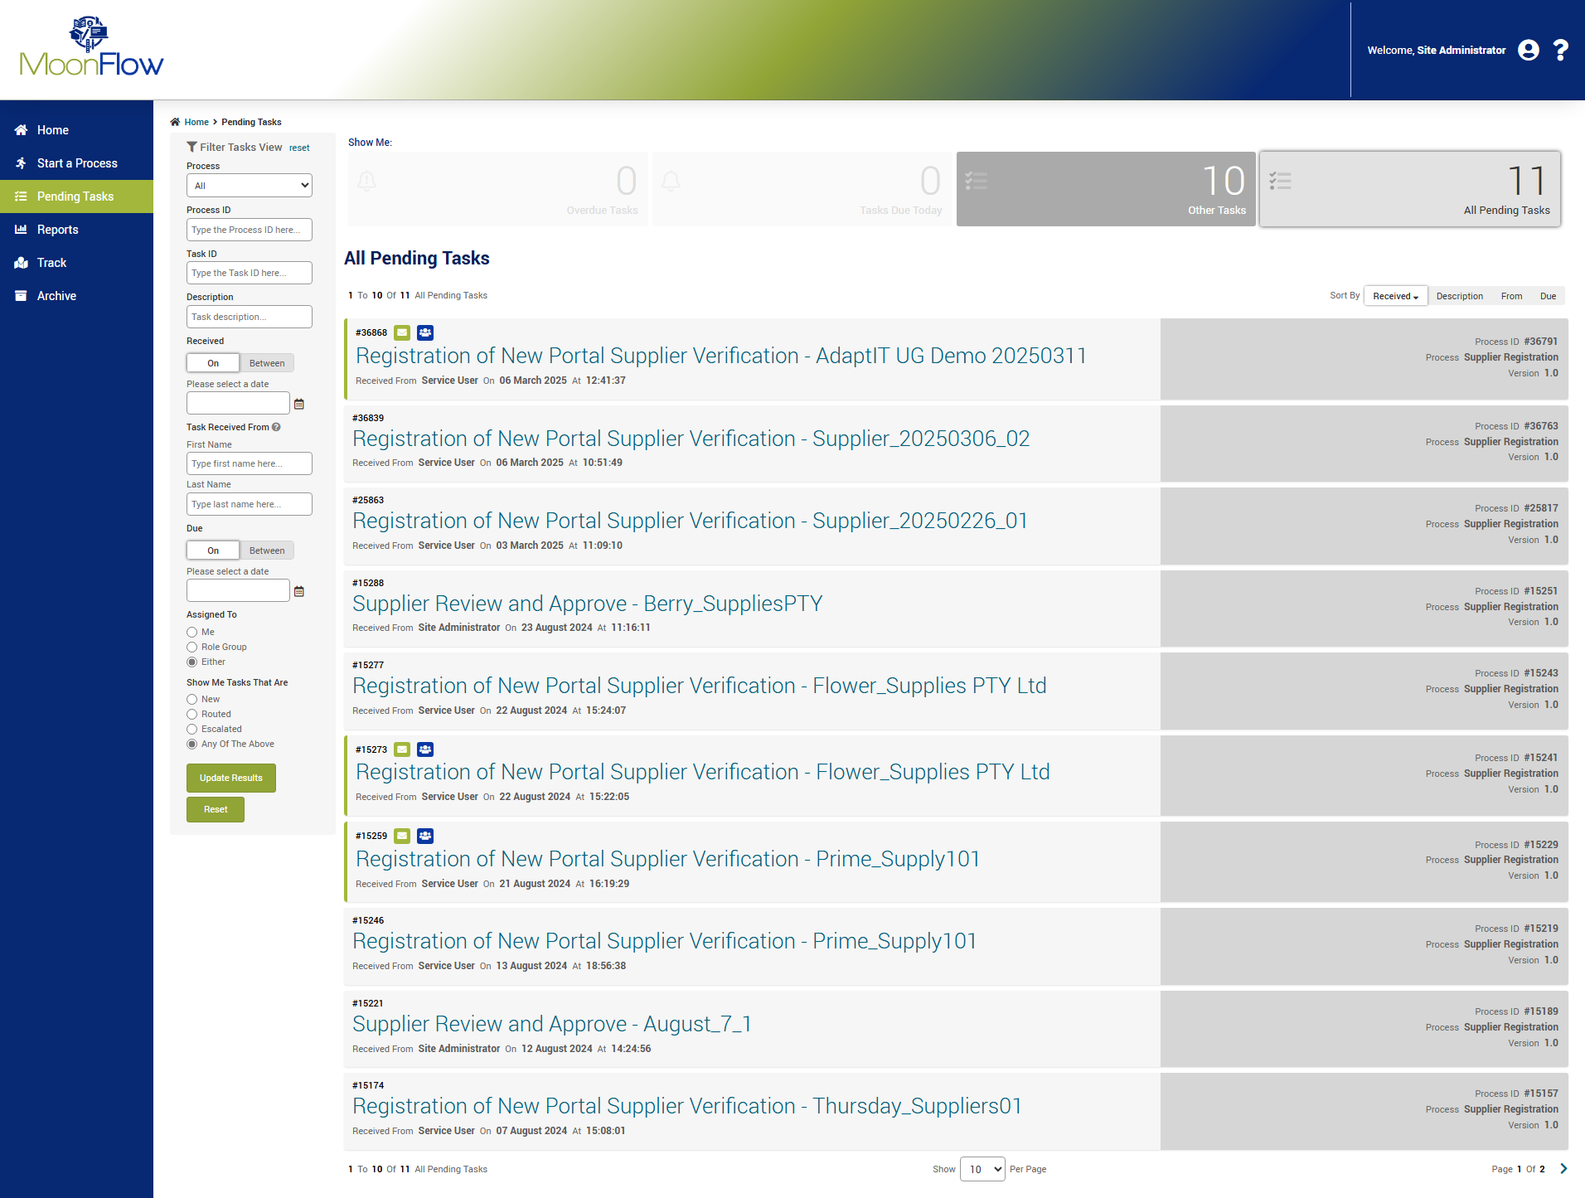

Slide 27
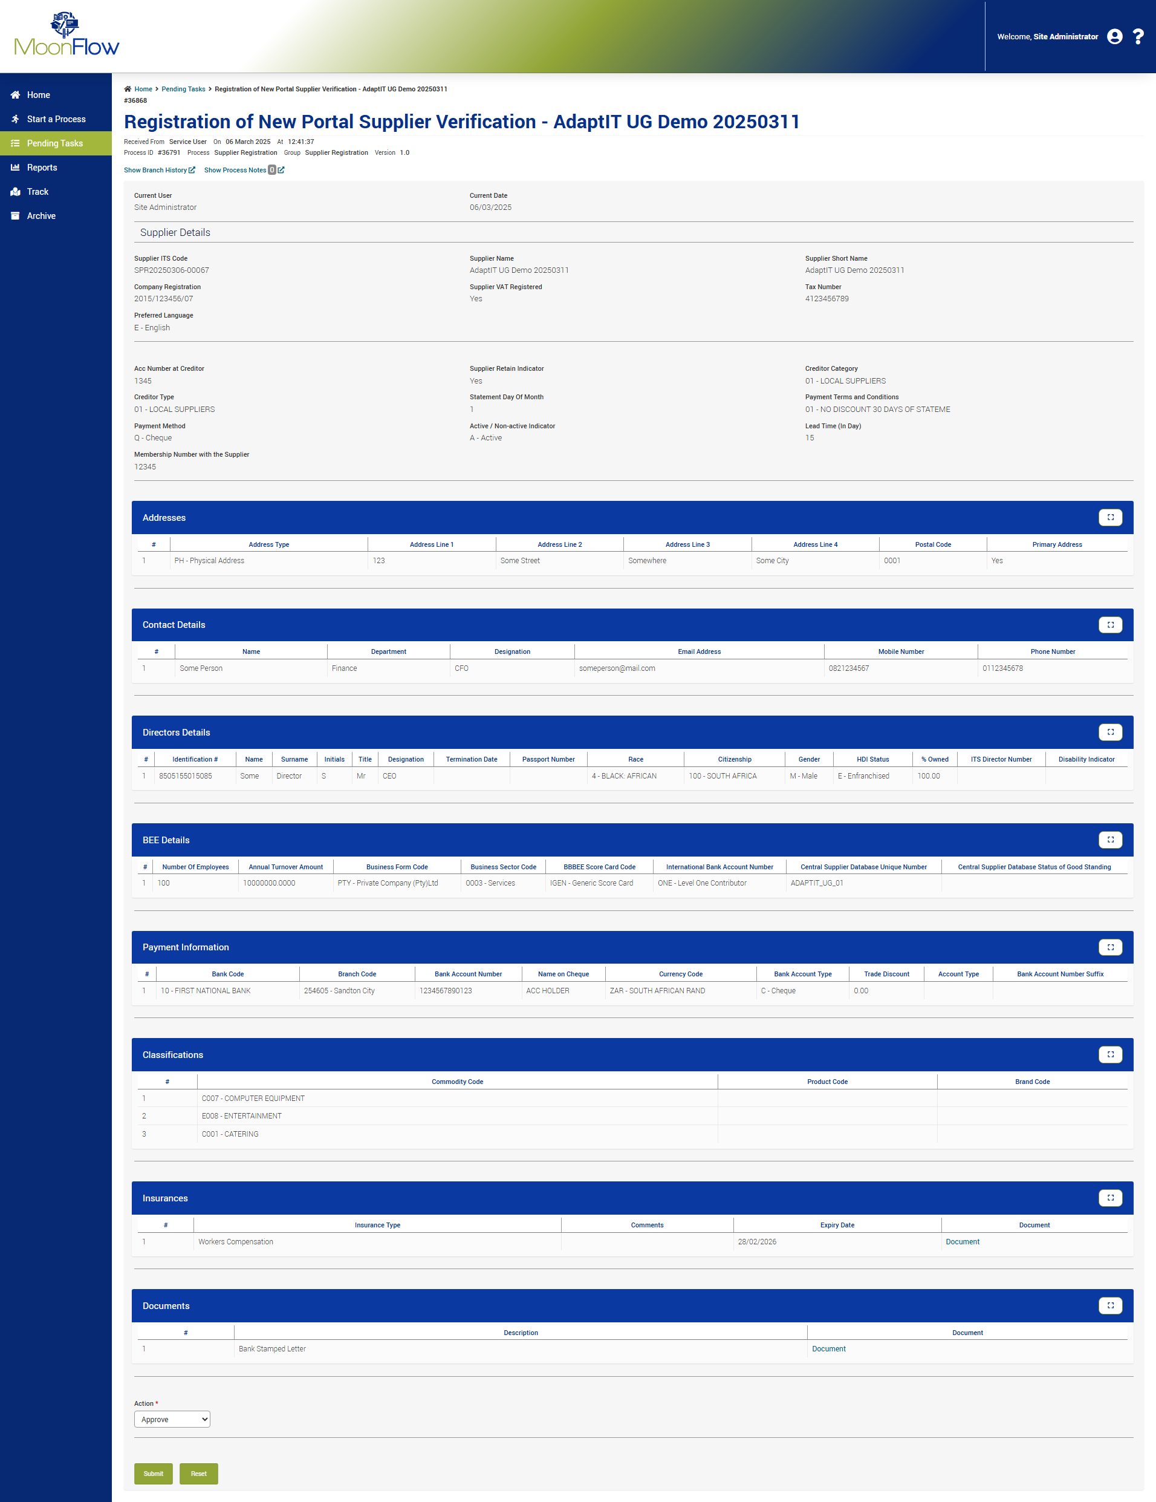

Slide 29


Slide 31
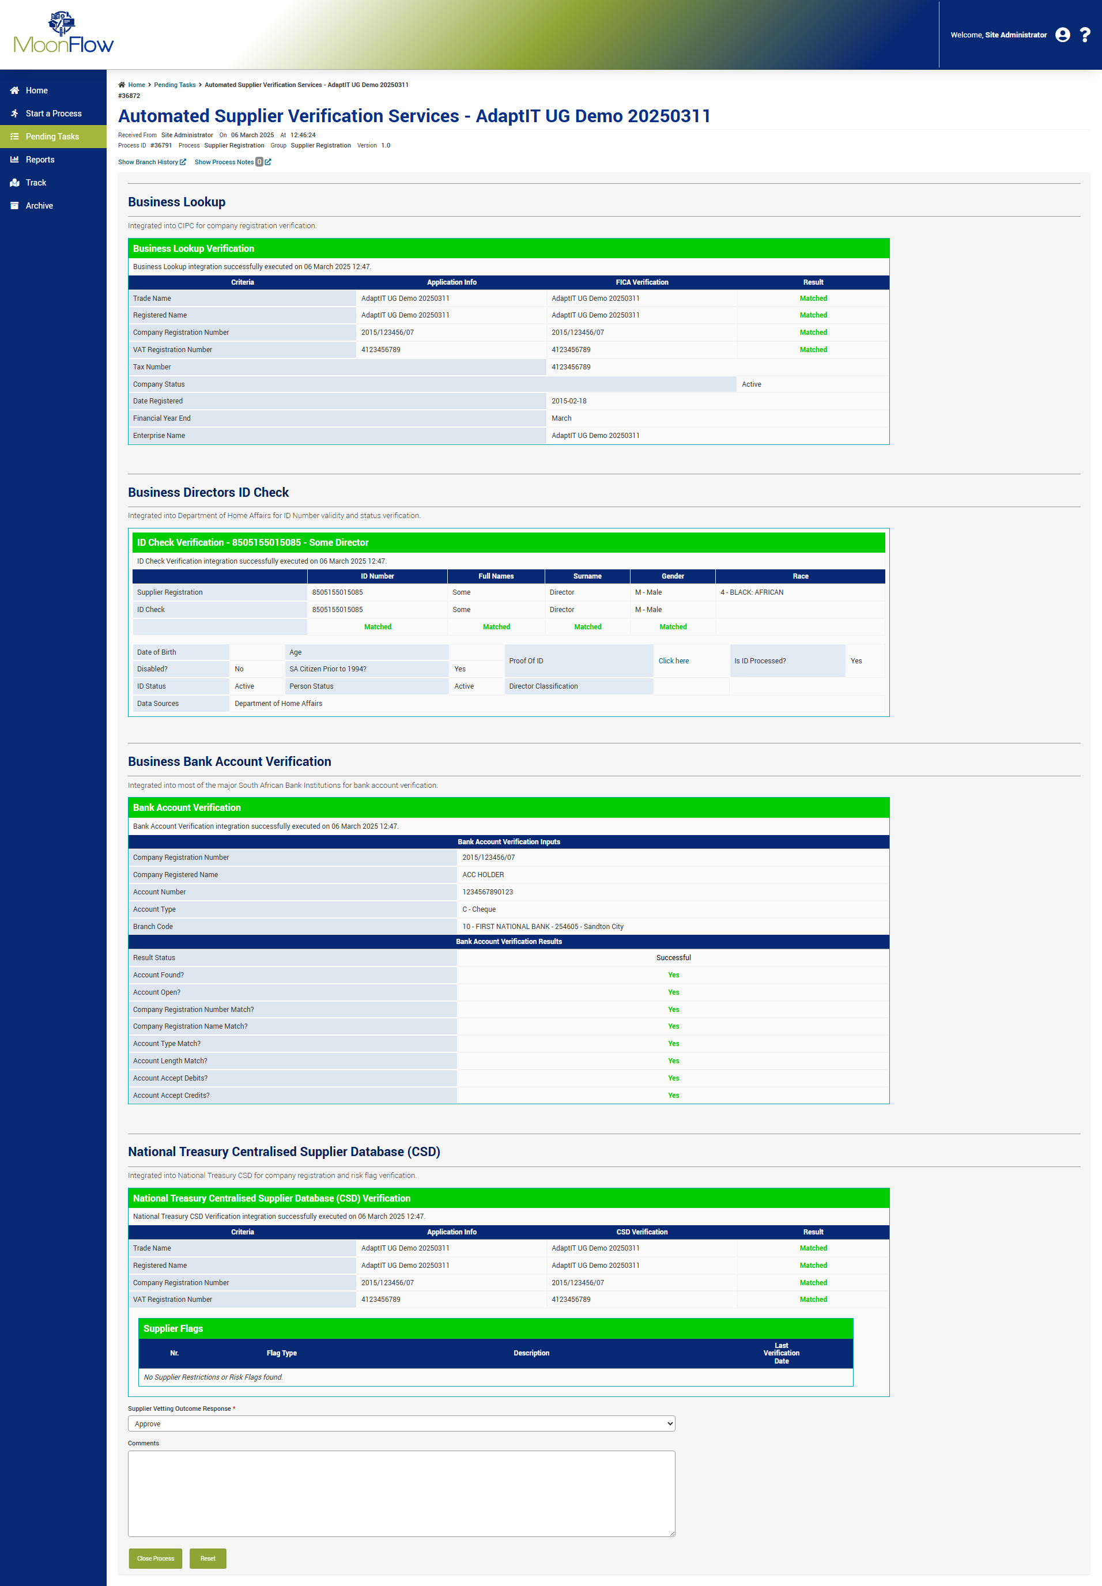

Slide 33
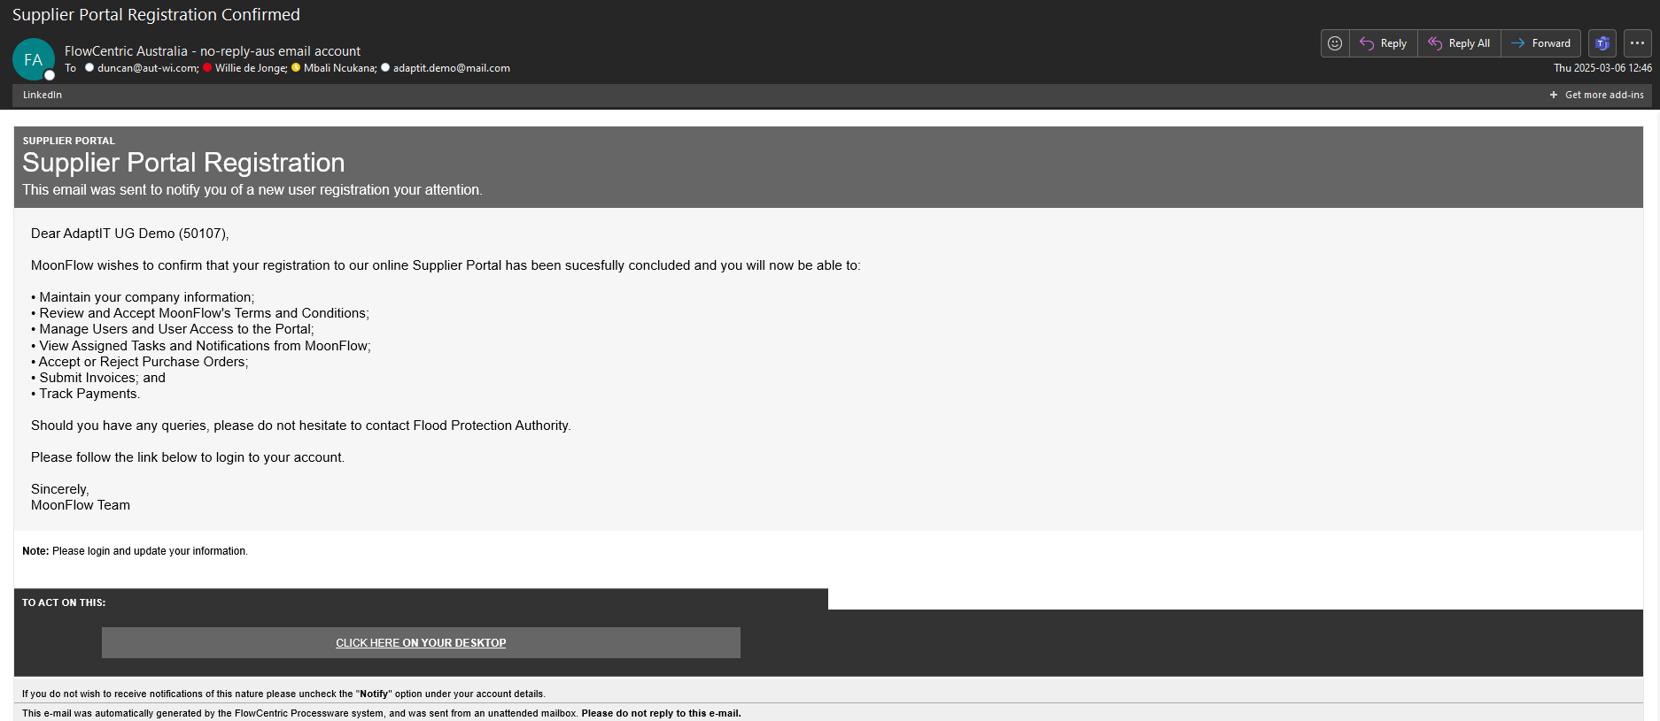
MC
MoonFlow Communications

Slide 34
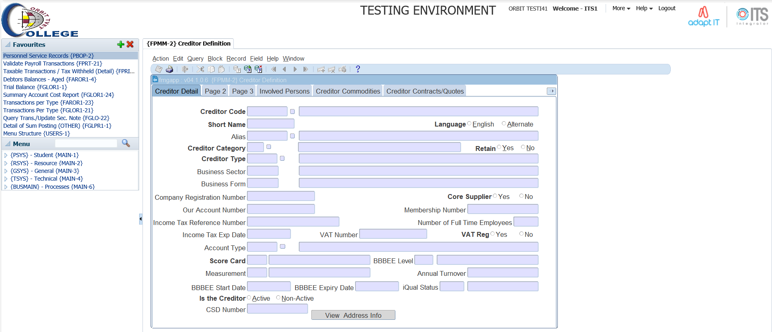

Slide 35
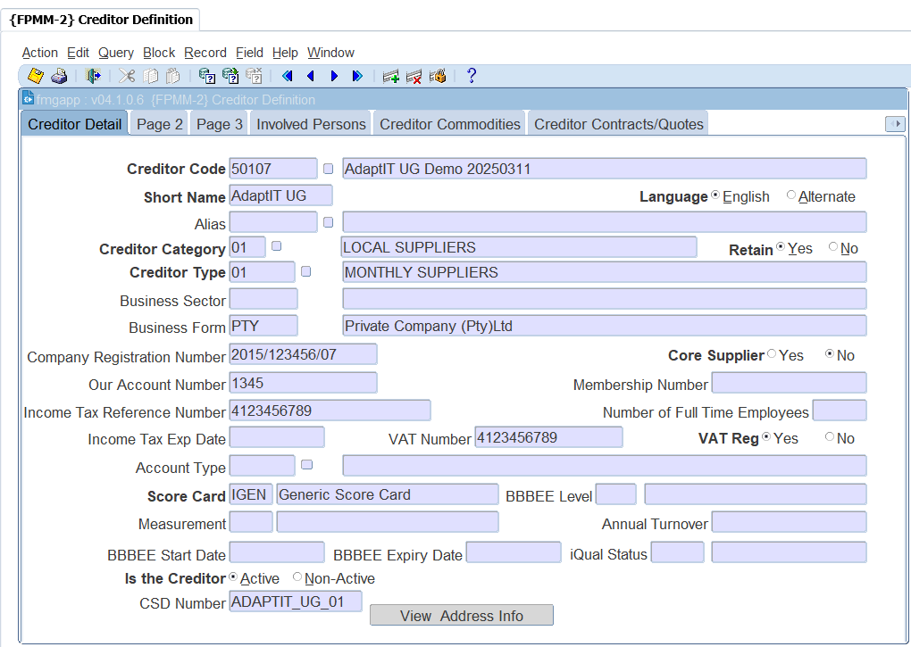

Slide 36
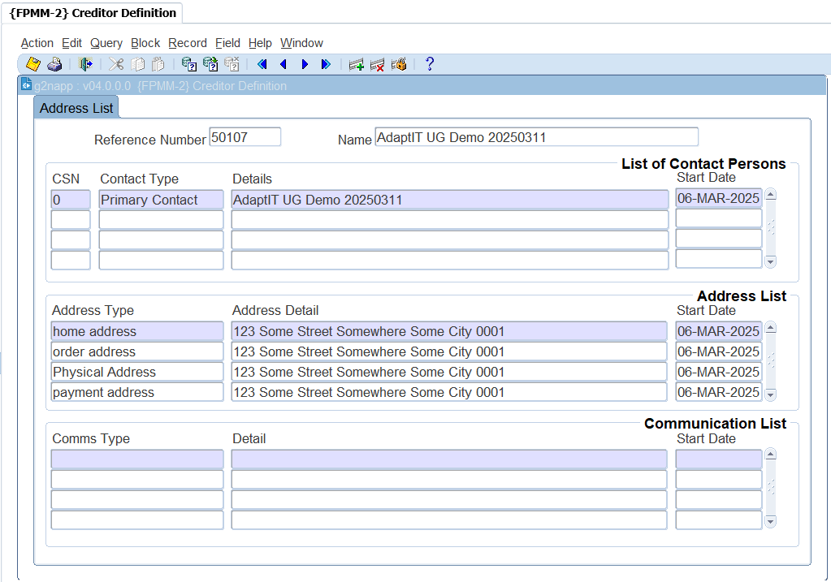

Slide 37
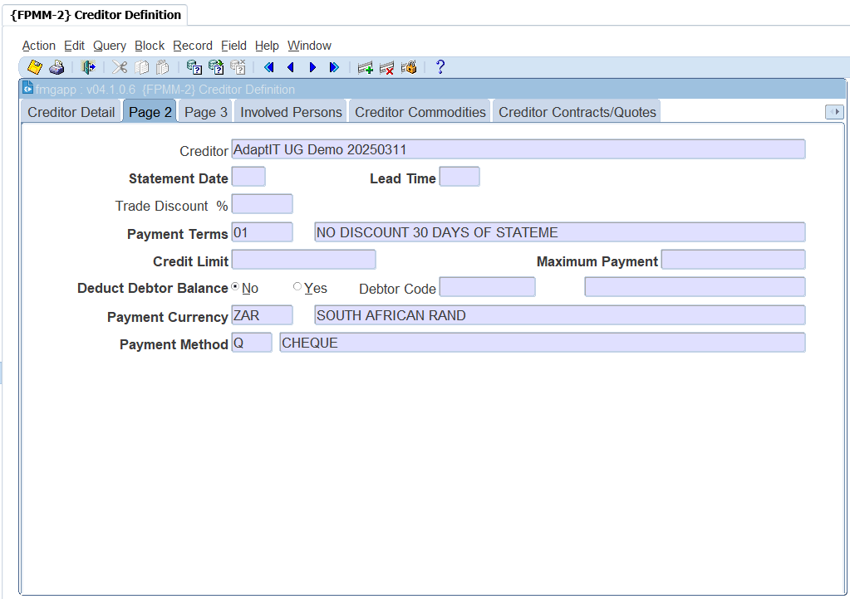

Slide 38
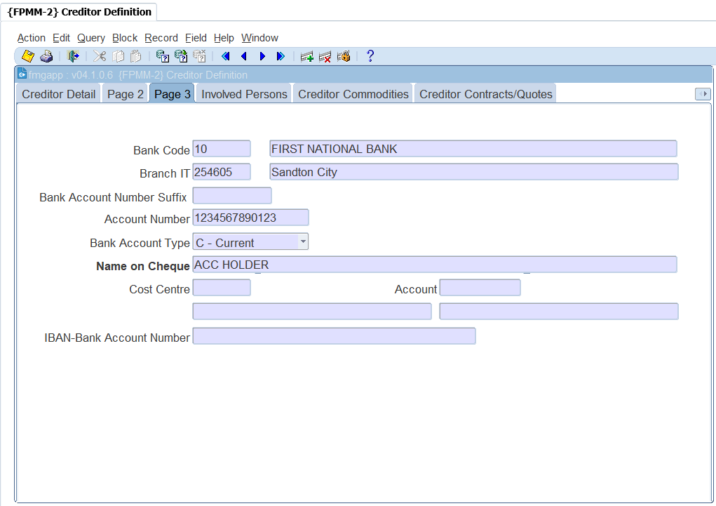

Slide 39
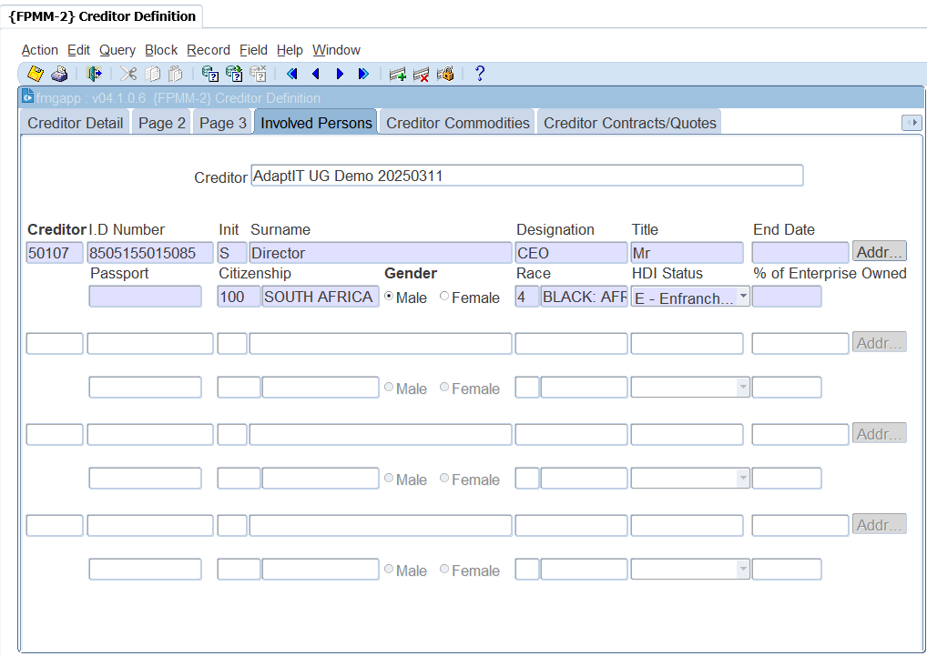

Slide 40
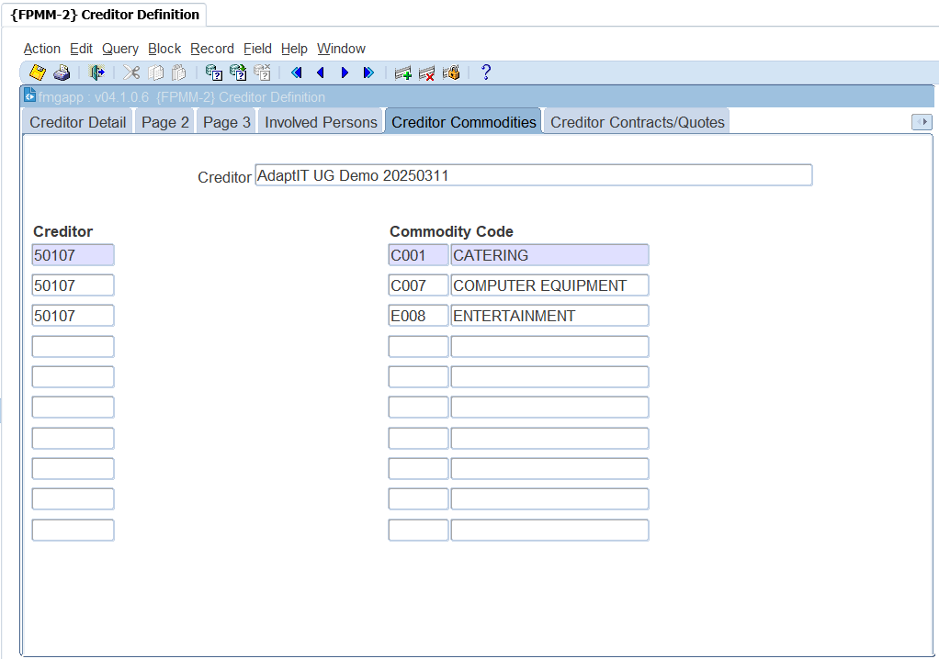

Slide 41
Way forward

Slide 42
Questions and Answers

Slide 43
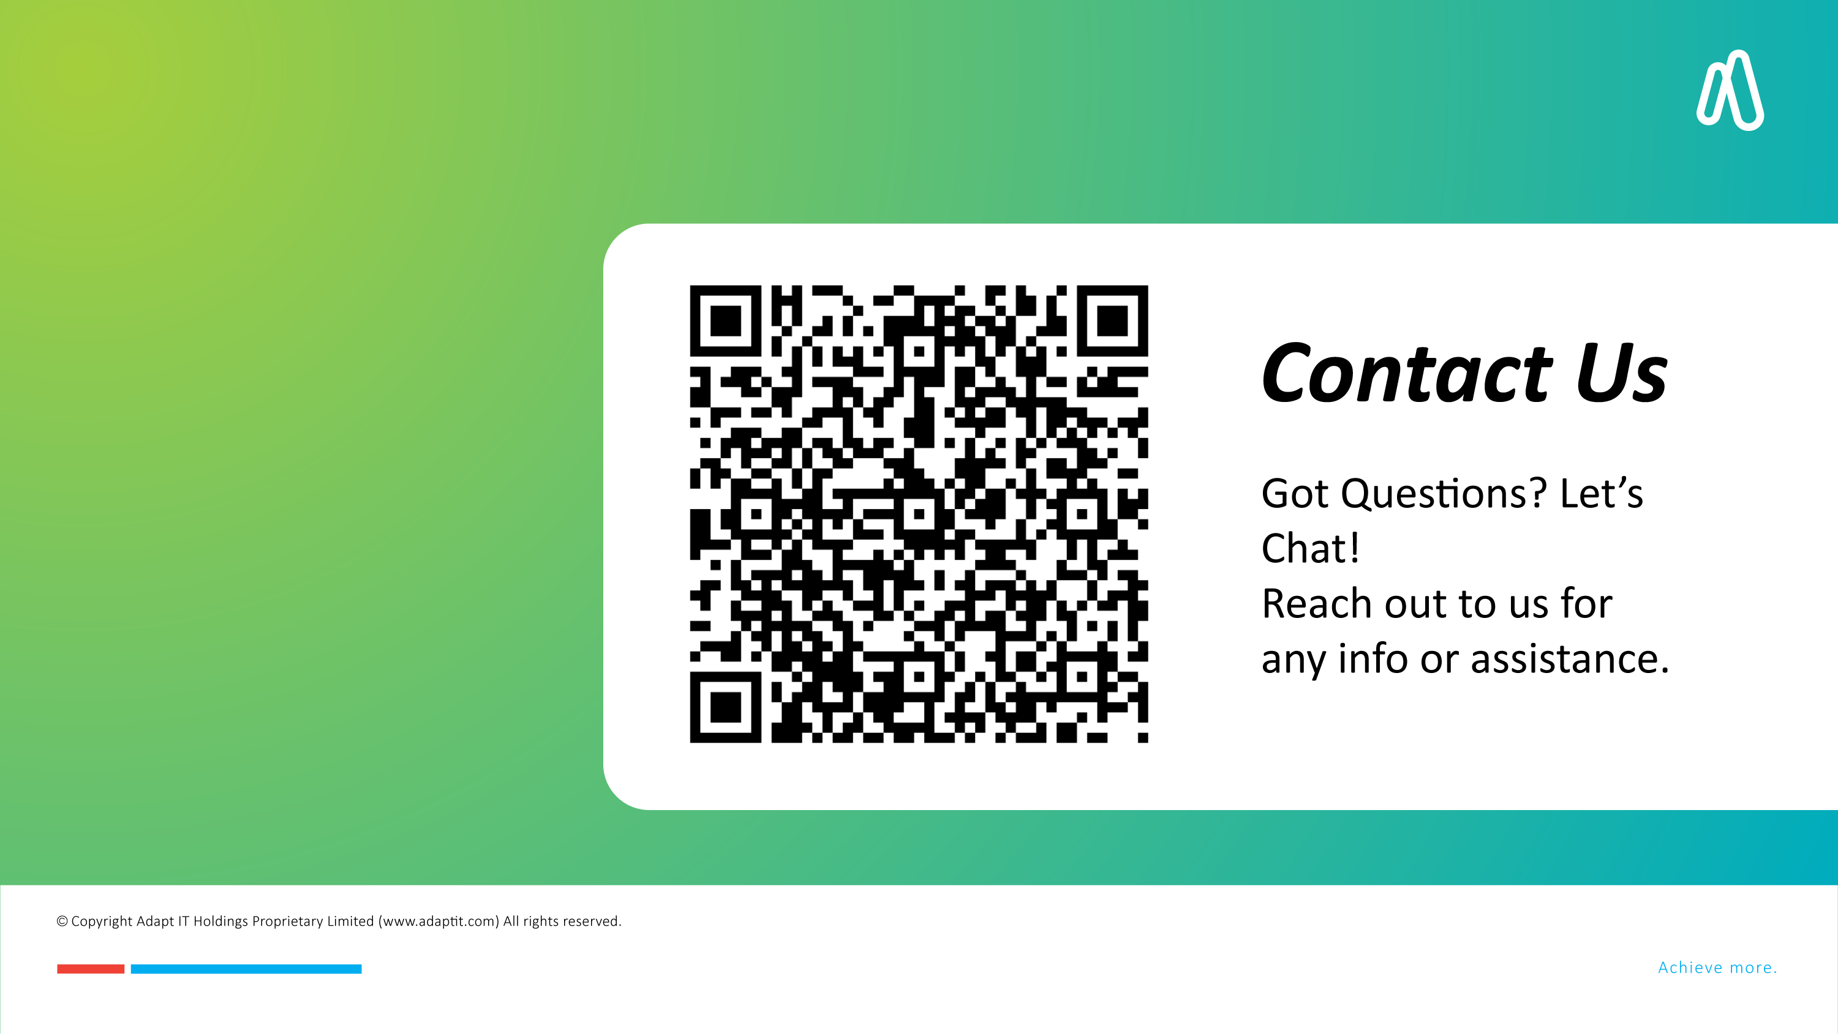
Questions and Answers

